Slide 1
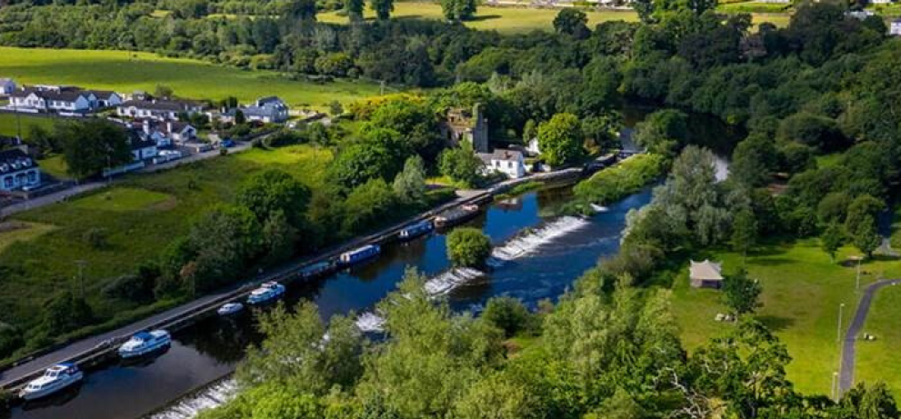
Public Webinar 11/01/2021
Draft Graiguenamangh/Tinnahinch Local Area Plan

Slide 2
Joint Local Area Plan – What and Why?
Local Area Plan is a public statement of planning policies
It is prepared in consultation with the local community
It sets out a strategy for the Proper Planning and Sustainable Development for the settlement
A joint approach by both local authorities ensures that the development of the settlement will be carried out in a co-ordinated and plan–led manner, maximising benefits to all residents within the settlement.
Forms the basis for funding applications

Slide 3
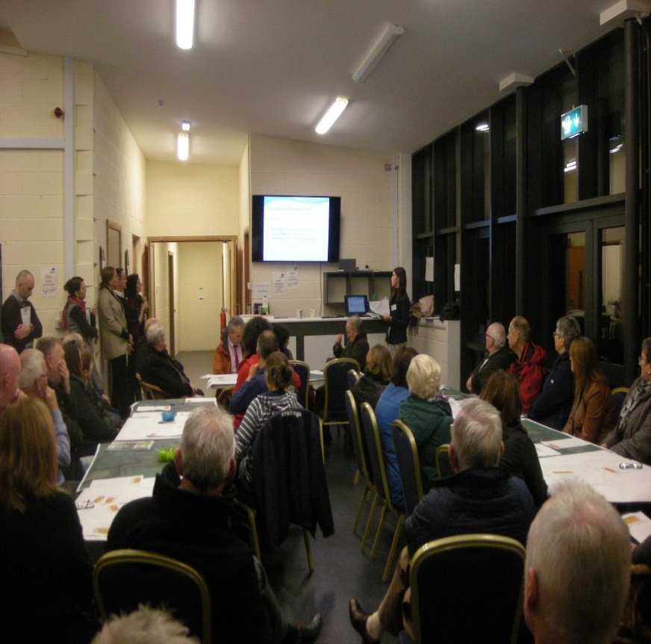
Pre-Draft Public Consultation (1)
Pre-draft review process commenced in 2019
Submissions invited from 16th October to 22nd November 2019
Pre draft public meeting at “The Hub” on 7 November 2019
64+ attendees

Slide 4
Pre-Draft Public Consultation (2)
Total of 9 written submissions were received
Issues included:
  Economic Development
  Tourism Development
  Educational requirements -Duiske College
  Zoning of lands
  Public realm improvements
  Infrastructural Requirements
  Pedestrian Accessibility
  Car Parking
  Protection of Natural and Built Heritage

Slide 5
Preparation of Draft Plan
Informed by pre-draft submissions and consultation with prescribed bodies / stakeholders
Comprises
Written statement with policies / objectives for future development
Land- use zoning map
Natura Impact Statement
Strategic Environmental Assessment
Strategic Flood Risk Assessment
Infrastructure Assessment

Slide 6
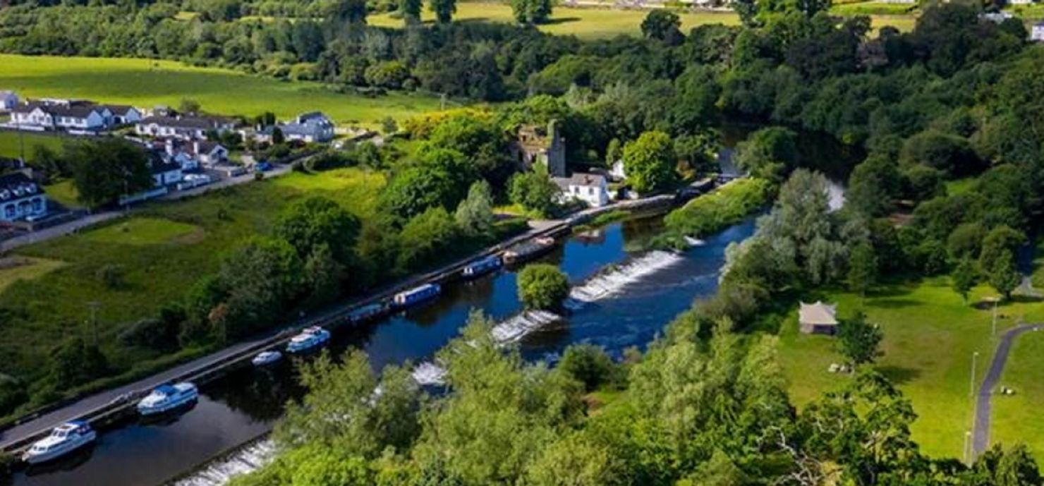
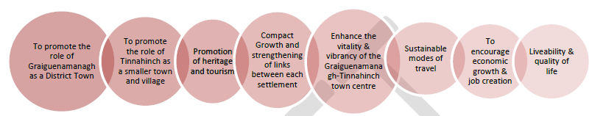
Strategic Objectives of the Plan

Slide 7
Joint Draft LAP – Some Key Messages (1)
Reversing population decline
Planning for Projected Growth in 2027
Graiguenamangh 1,666 (+ 277 persons) 103 res. units
Tinnahinch 355 (+49 persons) 18 res. units
* Provision also for serviced sites / low density residential development
Census of Population 1996-2016
 | 1996 | 2002 | 2006 | 2011 | 2016
Graiguenamanagh | 1,113 | 1,166 | 1,097 | 1,476 | 1,389
Tinnahinch | 261 | 269 | 326 | 315 | 306

Slide 8
Joint Draft LAP – Some Key Messages (2)
Town Centre Focused Regeneration-
  Re-use of vacant buildings – Tenancy issues
  Addressing dereliction
  Sensitive redevelopment and infill
  Improving public realm
  Creating a vibrant and viable Settlement
  Promoting Compact Growth – supporting delivery of residential, employment, retail and other services including new secondary school site in the settlement with focus on town centre

Slide 9

Joint Draft LAP – Some Key Messages (3)
Facilitating and Promoting Economic Development-
  Maximising tourism and food economy opportunities in particular maximising assets to compete as a tourism destination e.g. overnight stays /tourism facilities / river parks
  Zoning of lands to a accommodate employment uses in Graiguenamanagh and Tinnahinch
  Support for incubation space, hotdesking, start – up businesses

Slide 10
Joint Draft LAP – Some Key Messages (4)
  Provision of Infrastructure -
    Pedestrian and cycling infrastructure to improve integration between Graiguenamanagh and Tinnahinch – viability study for new pedestrian bridges in Tourism Concept study
    Seek improvements in footpaths / lighting/ road maintenance/ access to settlement / car parking etc.
    Support Irish Water in delivery of Water Services (Water and Wastewater infrastructure)

Slide 11
Joint Draft LAP – Some Key Messages (5)
  Provision of Infrastructure -
    Facilitate and support the provision of telecommunications, broadband, sustainable renewable technologies
    OPW Flood Relief Works - Plan supports delivery of flood relief works subject to heritage considerations and protection of integrity of historical settlement
    Flood Risk – assessment of potential risk of flooding has informed preparation of the Plan

Slide 12
Joint Draft LAP – Some Key Messages (6)
Built and Natural Heritage-
  Protecting and promoting unique natural and built heritage characteristics of the settlement
  Due regard the Special Area of Conservation
  Preserve the historic character of Graiguenamangh Architectural Conservation Area and ensure future development is appropriate-Sensitive conservation and reuse of protected buildings
  Need to encourage sensitive and sustainable development

Slide 13
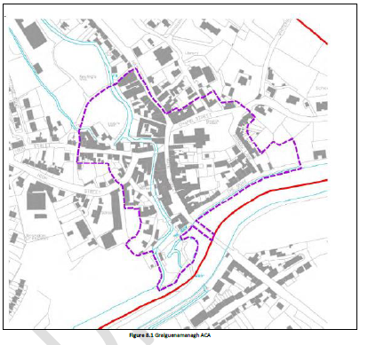
Architectural Conservation Area - Graiguenamanagh

Slide 14
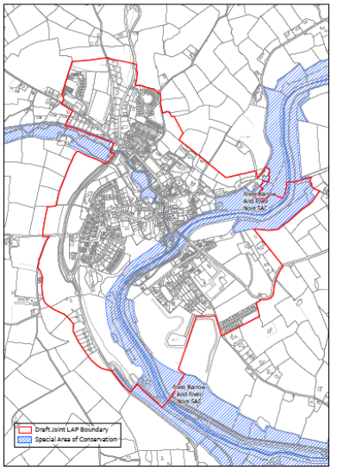
Special Area of Conservation

Slide 15
Graiguenamanagh– Housing
Demand
Lands Zoned Residential: 6.8 ha of land zoned residential
Includes 2 ha of land for low density residential
Potential to deliver: c. 137. no. Residential units within lands zoned residential +20 low density
Other res opportunities: Exiting residential and Mixed Use Zoning

Slide 16
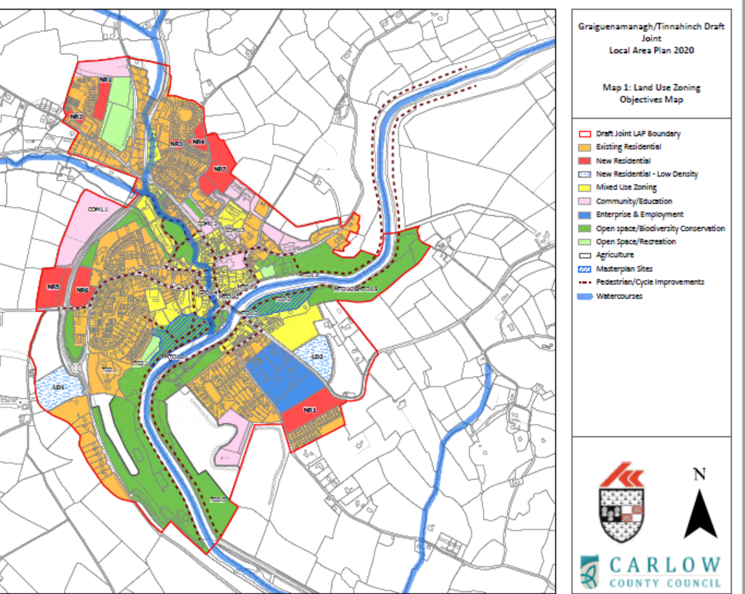
Land Use Zoning Changes - Graiguenamanagh
Removed Residential zoning
New School Site
Changed zoning to reflect current use
Masterplan Sites
Pedestrian/Cycle Improvements
Low Density Zoning

Slide 17
Masterplan Area
1: The Hub
Opportunities for the movement into and through the site
Increased connectivity with the River Barrow and existing pathways and trails
Identification of opportunities for tourist attractions and recreational amenities
Opportunity for the site to be developed as an events venue to support the towns festival programme
Identification of additional pedestrian and cycle links

Slide 18
Tinnahinch - Focus
  Create sustainable community to maintain viability of settlement
  Promote and facilitate tourism development
  Objective to support tourism development on proposed mixed use land zoning in Tinnahinch
  Tinnahinch riverside Masterplan to facilitate tourism and recreation

Slide 19
Masterplan Area
2: River Park
Create a high-quality visitor amenity space with new parkland, play space, infrastructure supports and utilities, parking and mooring facilities
Develop linkages (pathways and cycle lanes) to existing amenity walkways i.e. Barrow Way

Slide 20
Tinnahinch - Focus
  Provision of pedestrian and cycle infrastructure with improved connectivity between Graiguenamanagh and Tinnahinch
  Promotion of access to key heritage sites including Tinnahinch Castle and St. Michael’s Well
  Provision of community services in settlement including expansion of cemetery in Tinnahinch
  Promotion of employment opportunities (4.4ha Enterprise and Employment)

Slide 21
Tinnahinch – Housing
Demand 18 Private Housing Units and 7 Social Housing units
Lands Zoned Residential: 3.45ha of land zoned residential
Includes 1.52ha of land for low density residential/serviced sites
Potential to deliver: c. 40no. Residential units within lands zoned residential including 15 serviced sites
Other res opportunities: Existing residential and Mixed Use Zoning

Slide 22
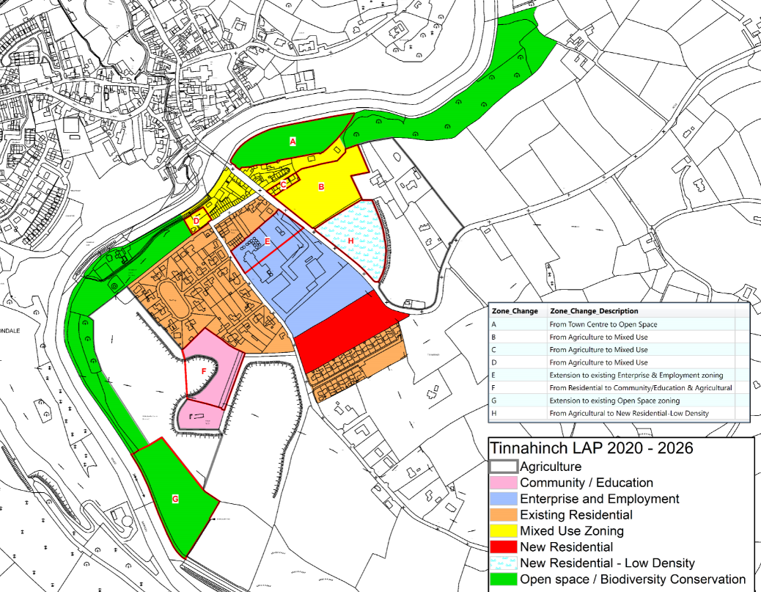
Land Use Zoning Changes - Tinnahinch

Slide 23
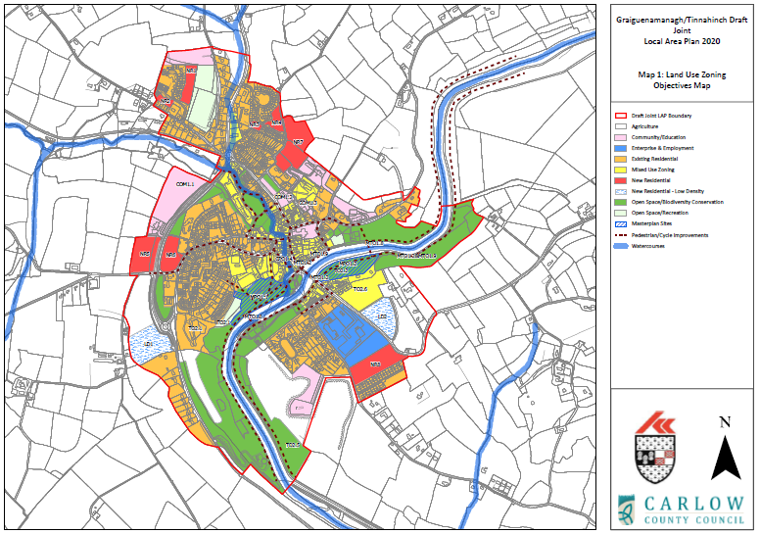
Draft Zoning Map

Slide 24
Next steps
Stage 2
Draft LAP
Draft Plan on public display for 8 weeks– submissions invited
Chief Executive's Report on submissions
Stage 3
Material Alterations to Draft
Public consultation (Material Alterations on public display)
Chief Executive's Report on Submissions
Consideration of CE's Report by Members
Material Amendments
Consideration of CE's Report by Members
Adoption of Plan
Notes:
8 week public display draft
Ad in the Kilkenny People.
4 weeks to prepare and submit a report to members.
Six weeks to make a decision
Could adopt, or if resolve to make changes, back out on public display.
At this stage, it’s an unknown, as it depends on the screening of the changes for the environmental reports.
But regardless, we should have an adopted plan in place by the end of the year at the latest.

Slide 25

Draft Plan
Submissions to be made by 25th January
On display:
• http://consult.kilkenny.ie
• https://consult.carlow.ie/
• Planning Office, Kilkenny County Council, County Hall, John Street, Kilkenny (by appointment only during normal opening hours as per Covid-19 Guidelines)
• Planning Office, Carlow County Council, County Buildings, Athy Road, Carlow (by appointment only during normal opening hours as per Covid-19 Guidelines)

Slide 26
Submissions to:
• online at http://consult.kilkenny.ie/ or
• online at https://consult.carlow.ie/ or
• by e-mail to ourplan@kilkennycoco.ie or
• by e-mail to jointLAP@carlowcoco.ie or
In writing to:
• The Senior Planner, Planning Department, Kilkenny County Council, County Hall, John Street, Kilkenny or
• The Senior Planner, Planning Department, Carlow County Council, County Buildings, Athy Road, Carlow.
Thank you

